Slide 1

Predicting Home Values in Ames, Iowa
Group #1
Sasha, Ankit, Jacob, Ben

Slide 2

INTRODUCTION

Slide 3
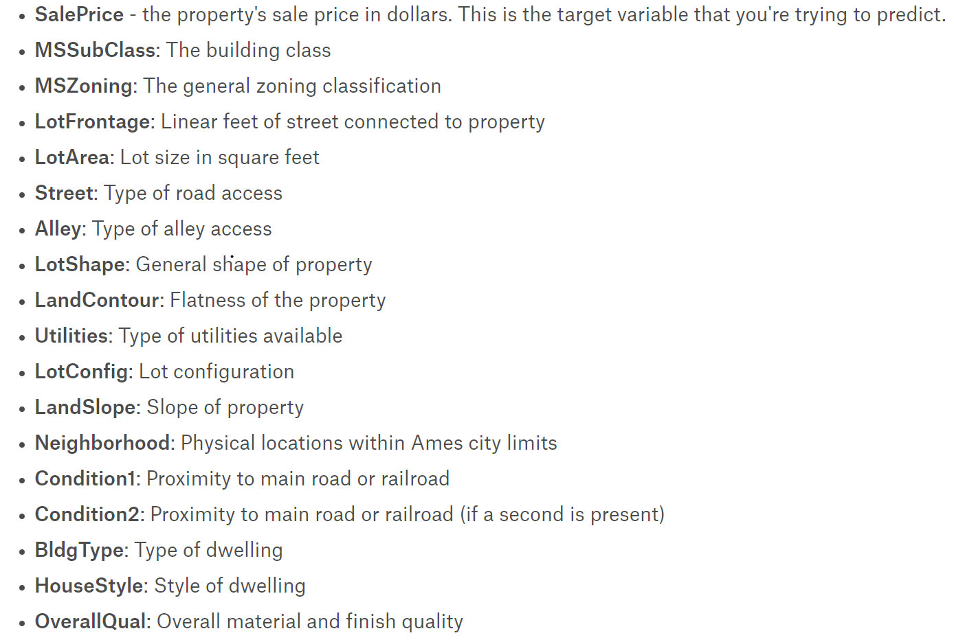
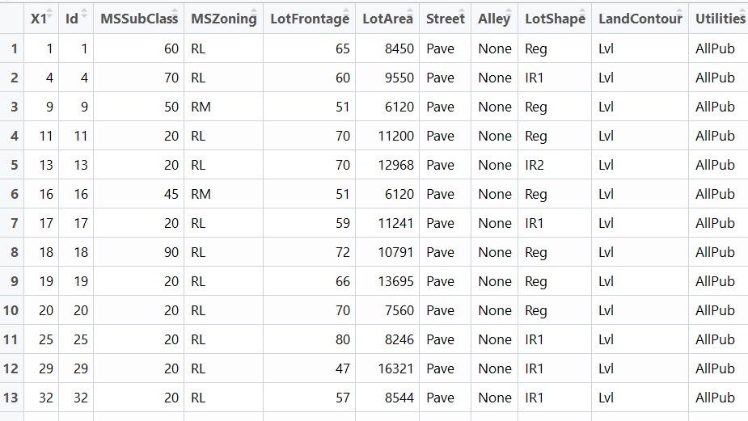
Business Problem
With 79 explanatory variables describing (almost) every aspect of residential homes in Ames, Iowa, our goal was to predict the final price of each home.
Example of Variables
Example of Data

Slide 4
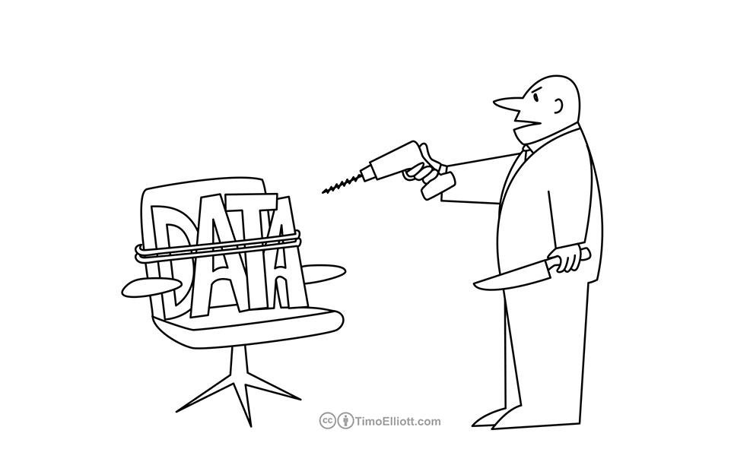
Torture the data, and it will confess to anything
~ Ronald Coase, Economics, Nobel Prize Laureate

Slide 5
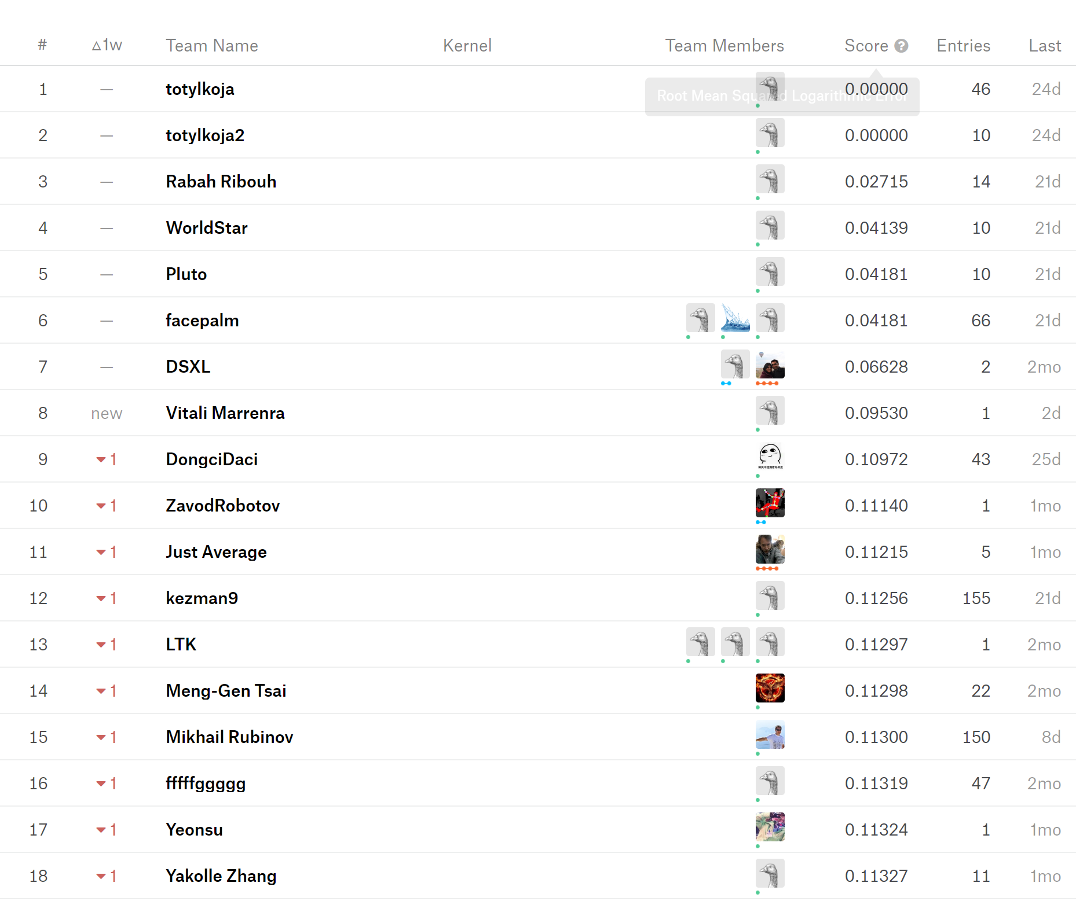
Presentation Outline
Quest for .11
Exploratory Data Analysis
Linear Regression
Decision Tree
Random Forest
Support Vector Machines
Best Model and comments
Conclusion and Applications
Validation Approach:
Train Set - 1017
Validation Set- 436
Test Set - 1459
Notes:
RMSLE – Root Mean Square Log Error

Slide 6
Exploratory Data Analysis

Slide 7
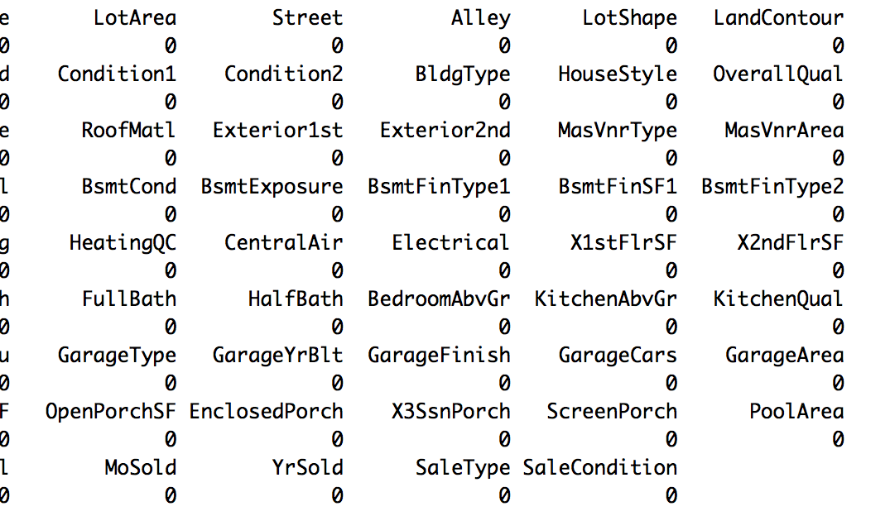
Dealing with missing data
NA in our dataset didn’t always mean NA
A 0 didn’t always mean 0
Used R package “mice” to fill in missing values in the data set
Notes:
NA in some fields meant that the feature was not available in the home, not that the data was unavailable
A 0 in finished basement SF didn’t mean that there was no basement, have to look at multiple variables to determine the specifics of that one feature

Slide 8
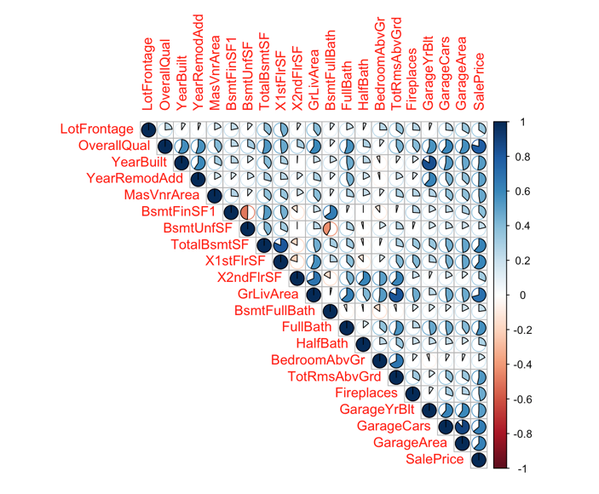
Exploratory Data Analysis
Covariation Matrix of
Numeric and Integers
Important Variables
SalePrice
GrLivingArea
FullBath
TotalBsmtSF
OverallQual
Notes:
- Initial point of analysis of numeric variables to discern what variables are impacting sales price
- The important variables are highly co-correlated, meaning they are correlated with other values

Slide 9
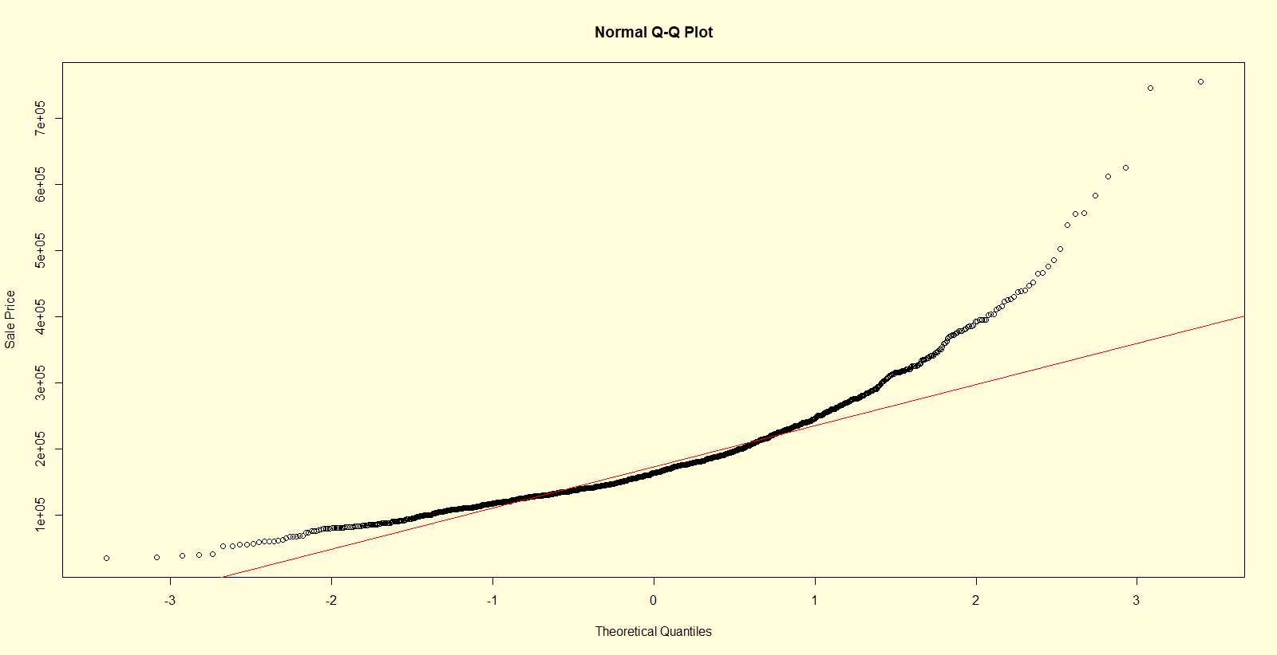
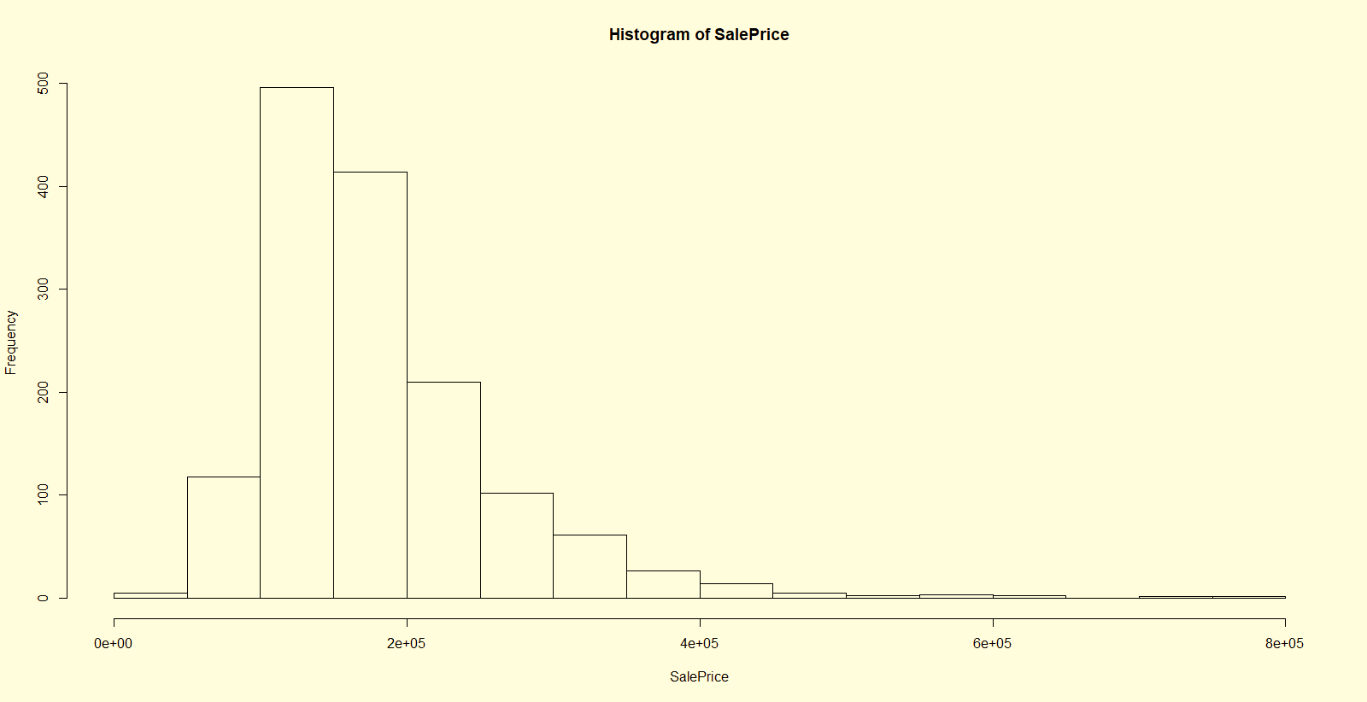
Univariate Analysis- SALE PRICE
Notes:
Non-normal
skewness(SalePrice) #deviates from normal distribution and has skewness
[1] 1.879009
> kurtosis(SalePrice) #peak is sharp
[1] 6.496789

Slide 10
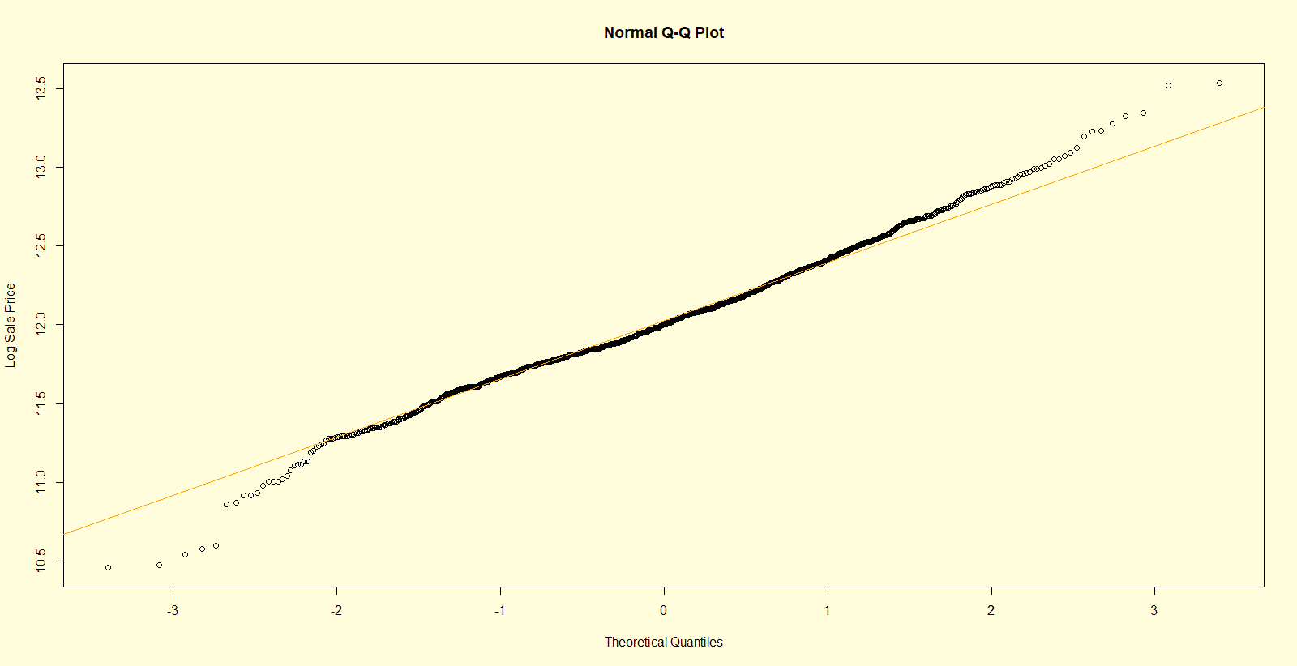
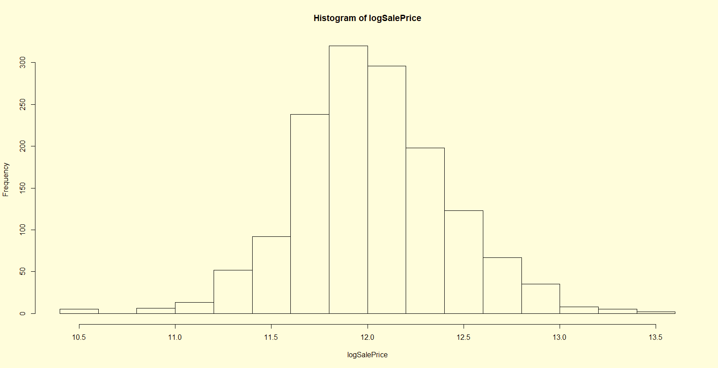
LOG TRANSFORMATIONS - LOGSALEPRICE
Notes:
skewness(logSalePrice) #normal distribution and has no skewness
[1] 0.1210859
kurtosis(logSalePrice) #peak is not sharp
[1] 0.7974482
The same log transformation was applied to
Above Ground Living Area
Total Basement Square Footage

Slide 11
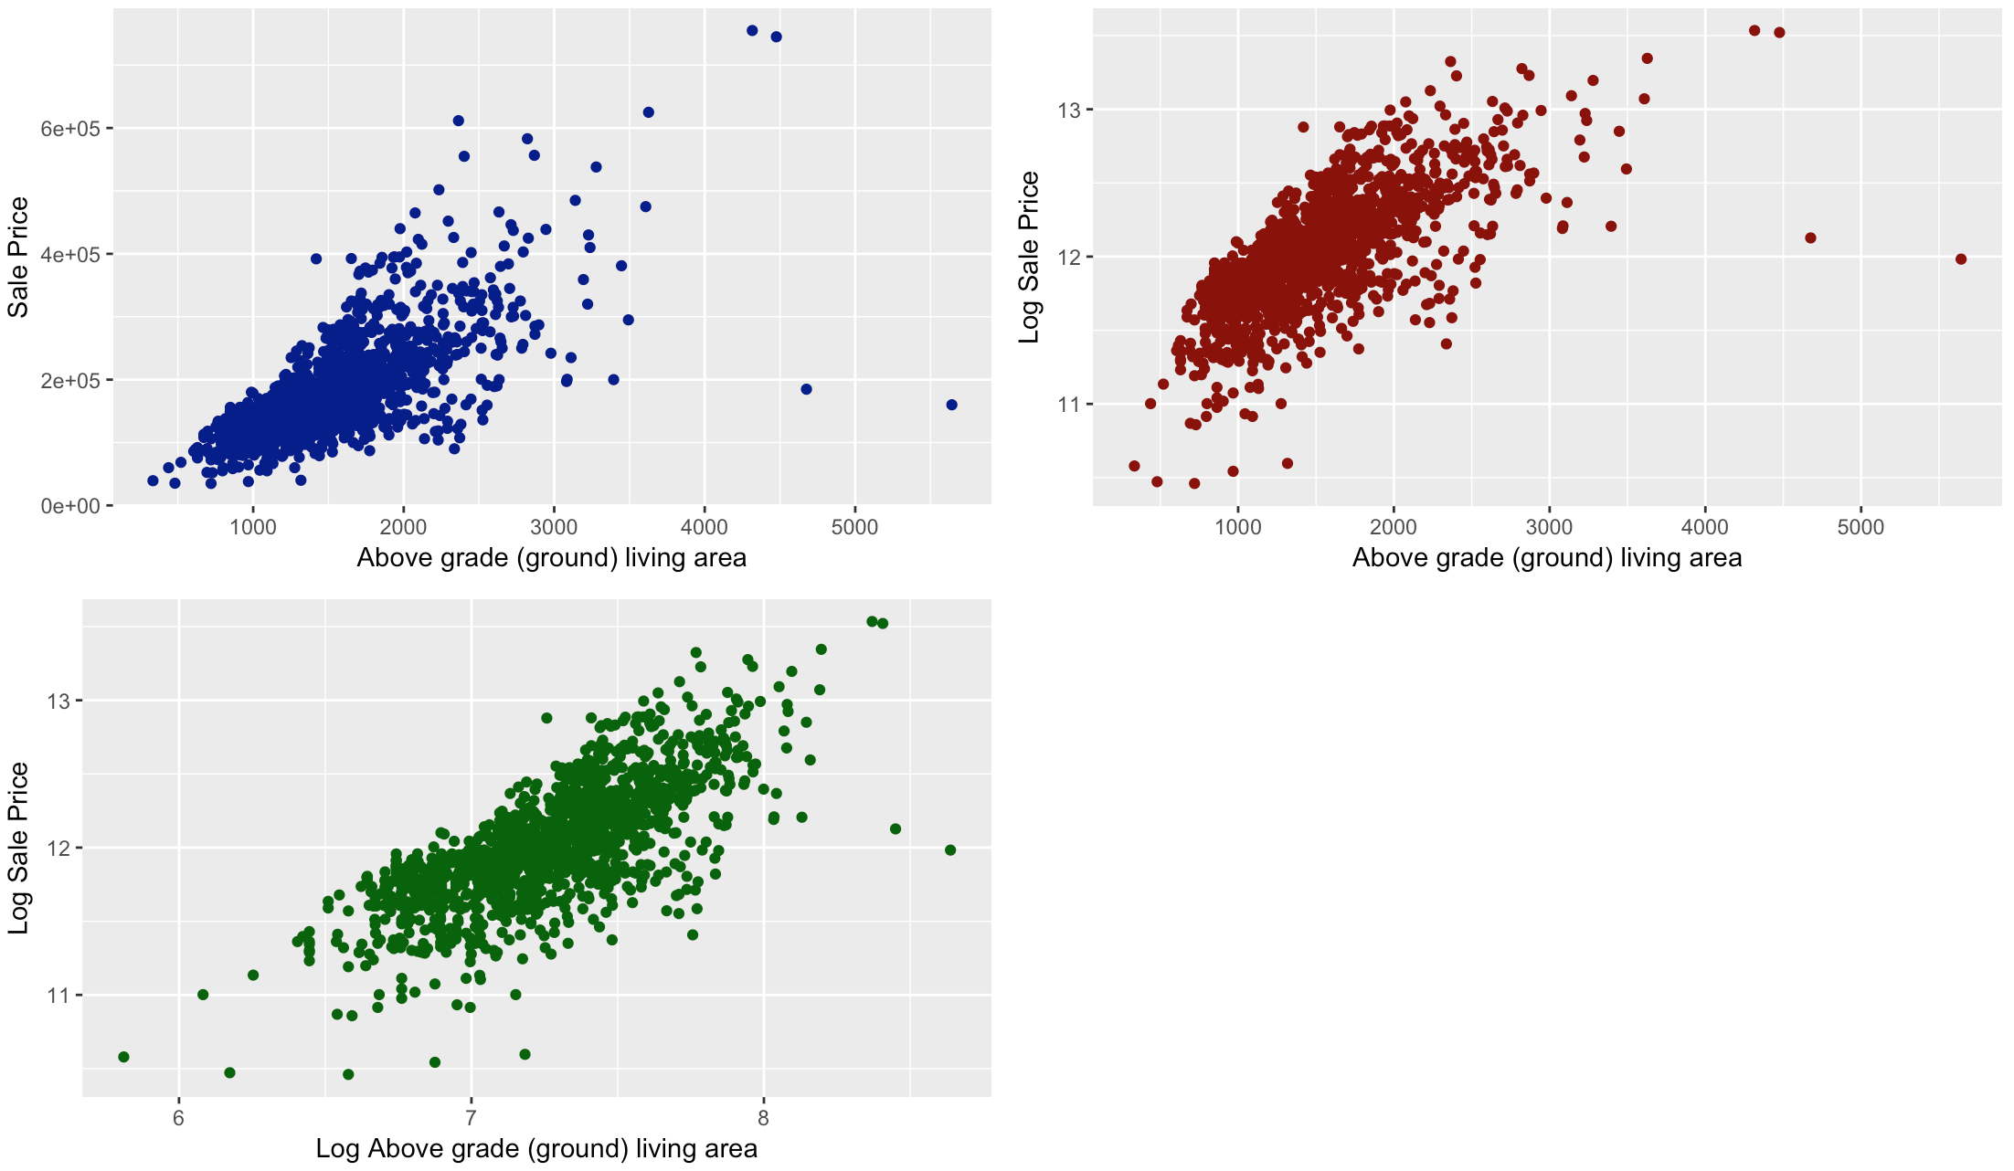
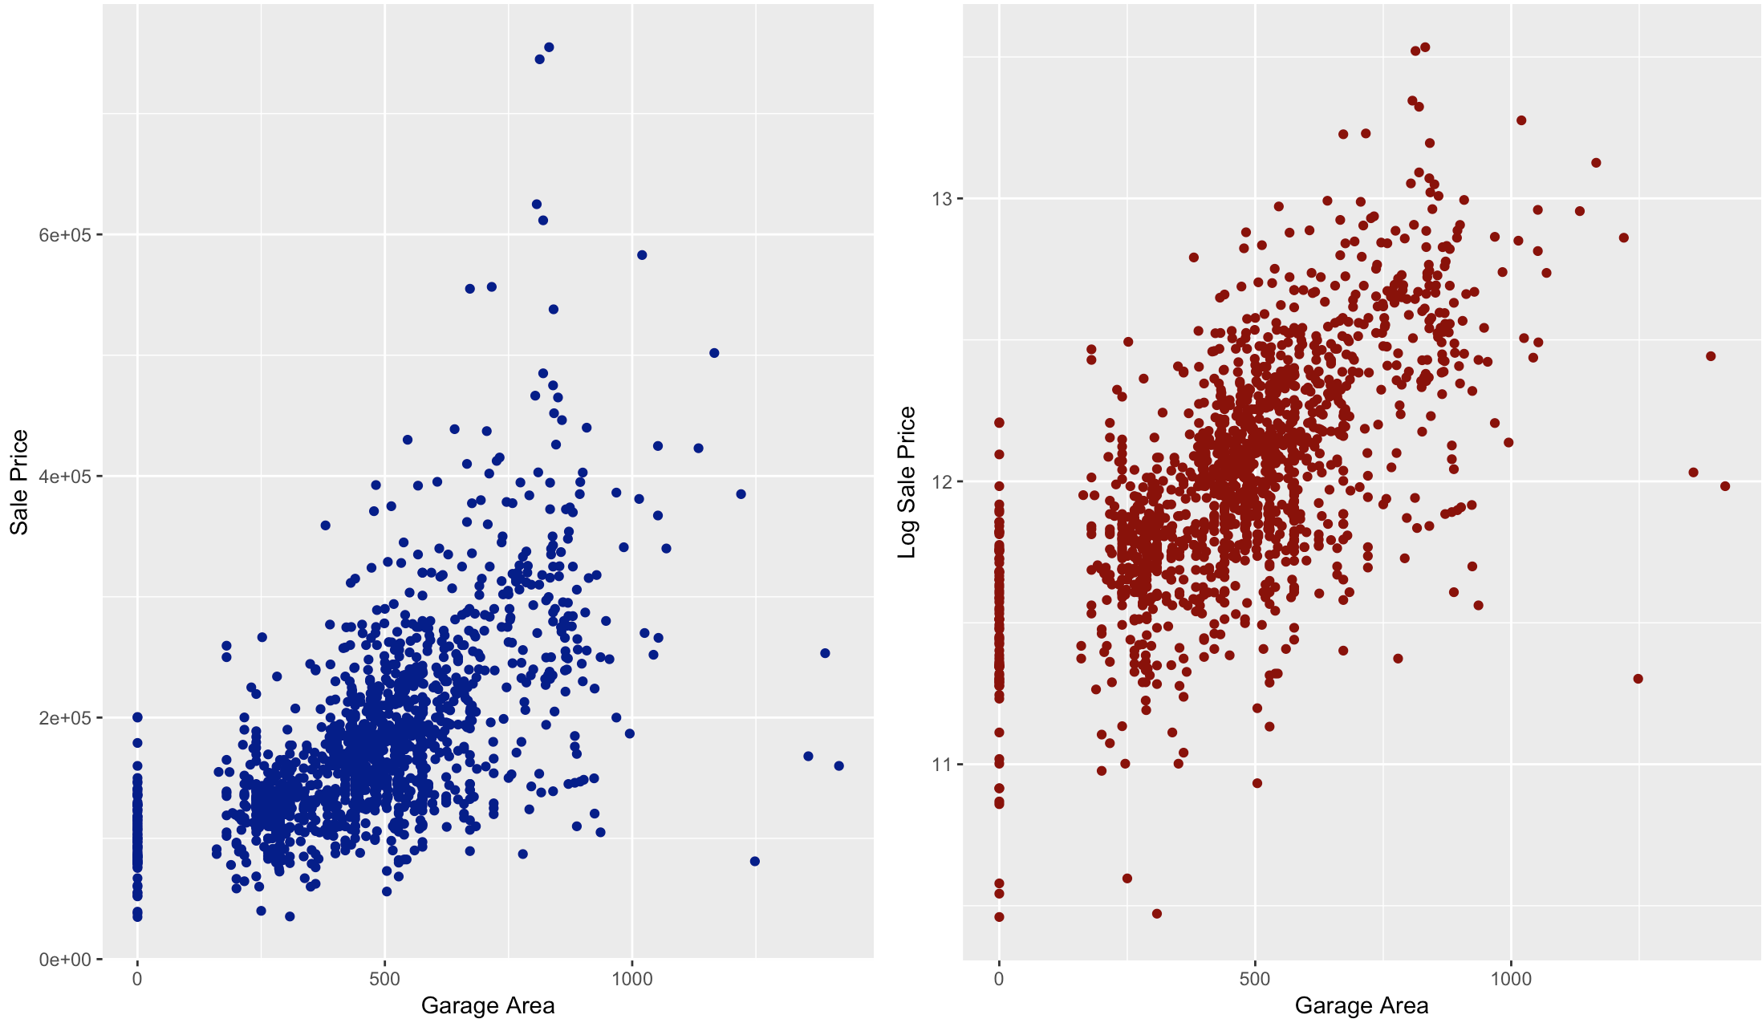
Bi-variate analysis OUTLIER DETECTION
Notes:
Outlier Detection
Rows 1183,1299, 582,1191,1062,186, and145 are outliers
*change graph to show 4 outliers

Slide 12
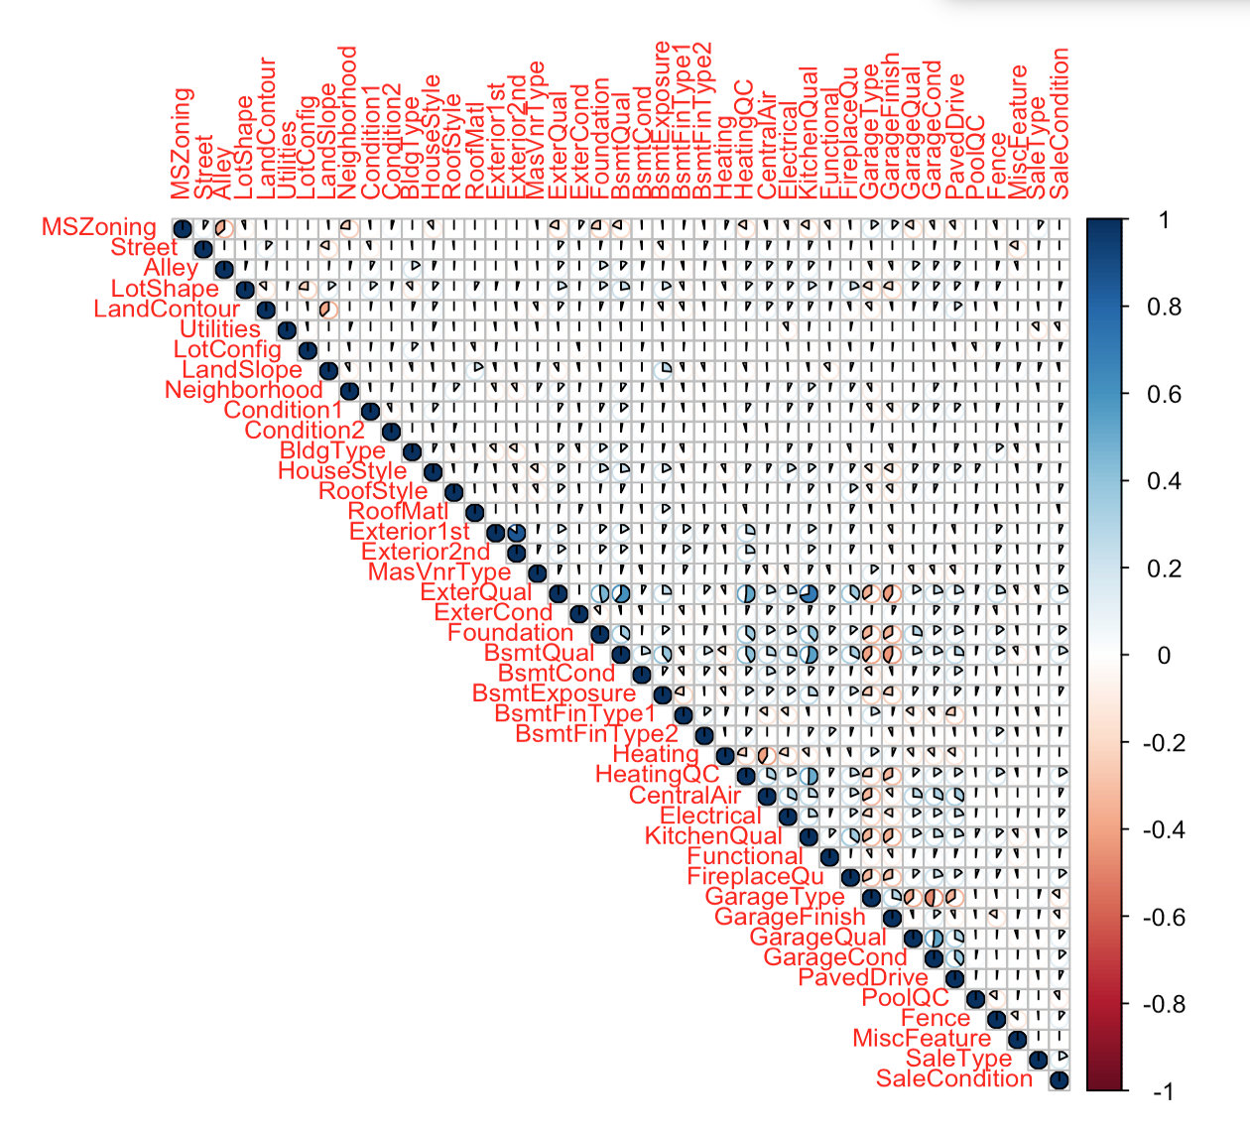
Ordinal Correlation
ExterQual (Exterior Quality)
PoolQC (Pool Quality)
SaleCondition
Street
LotShape
LandContour
Utilities
LotConfig (Lot Configuration)
RoofMatl (Roof Material)
Condition1
Correlation matrix showing correlations less than 0.3
Notes:
Ordinal to numeric conversions
PoolQC (Pool Quality)
SaleCondition
LotConfig (Lot Configuration)
RoofMatl (Roof Material)

Slide 13
Combine Variables
A X B variables
YearBuilt X OverallQual
YearRemodAdd X OverallQual
logTotalBsmtSF X OverallQual
logGrLivArea X OverallQual
FullBath X OverallQual
Notes:
We’re keeping overall quality because if we exclude overall quality we will lose explanatory power.

Slide 14
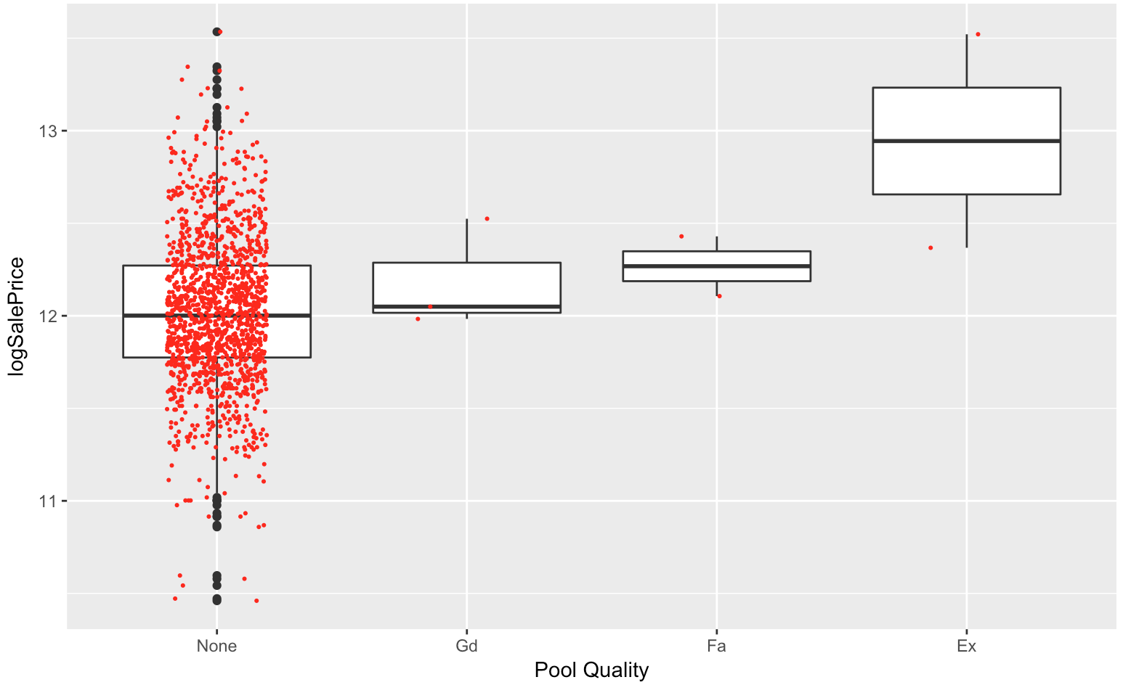
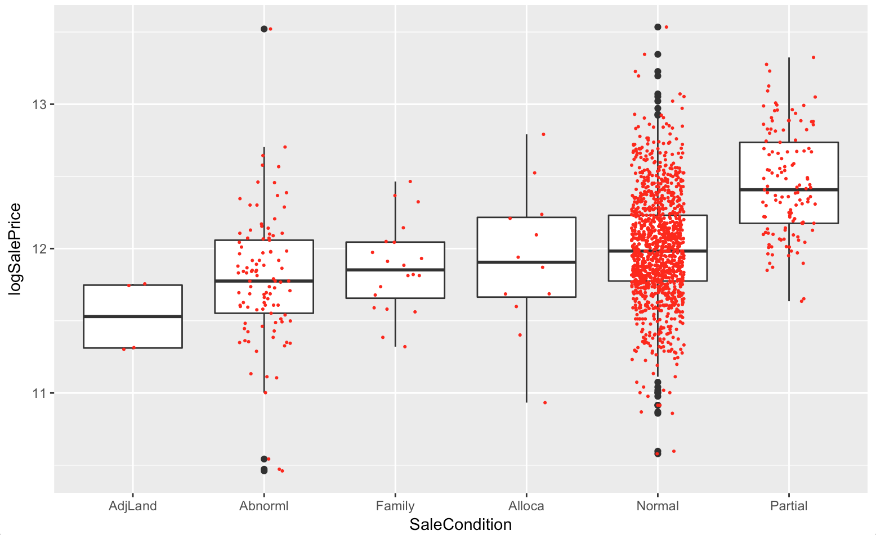
New Variables – Category reduction
Notes:
Old Variable: PoolQC ; New Variable : pool_good 1 or 0
Old Variable: SaleCondition ; New Variable : Sale_cond Partial <- 4 Normal, Alloca<- 3 Family,Abnorml<- 2 AdjLand <- 1
Old Variables Neighborhood ; New Variable RichNeighborhood 1 or 0 Condition Red Line

Slide 15
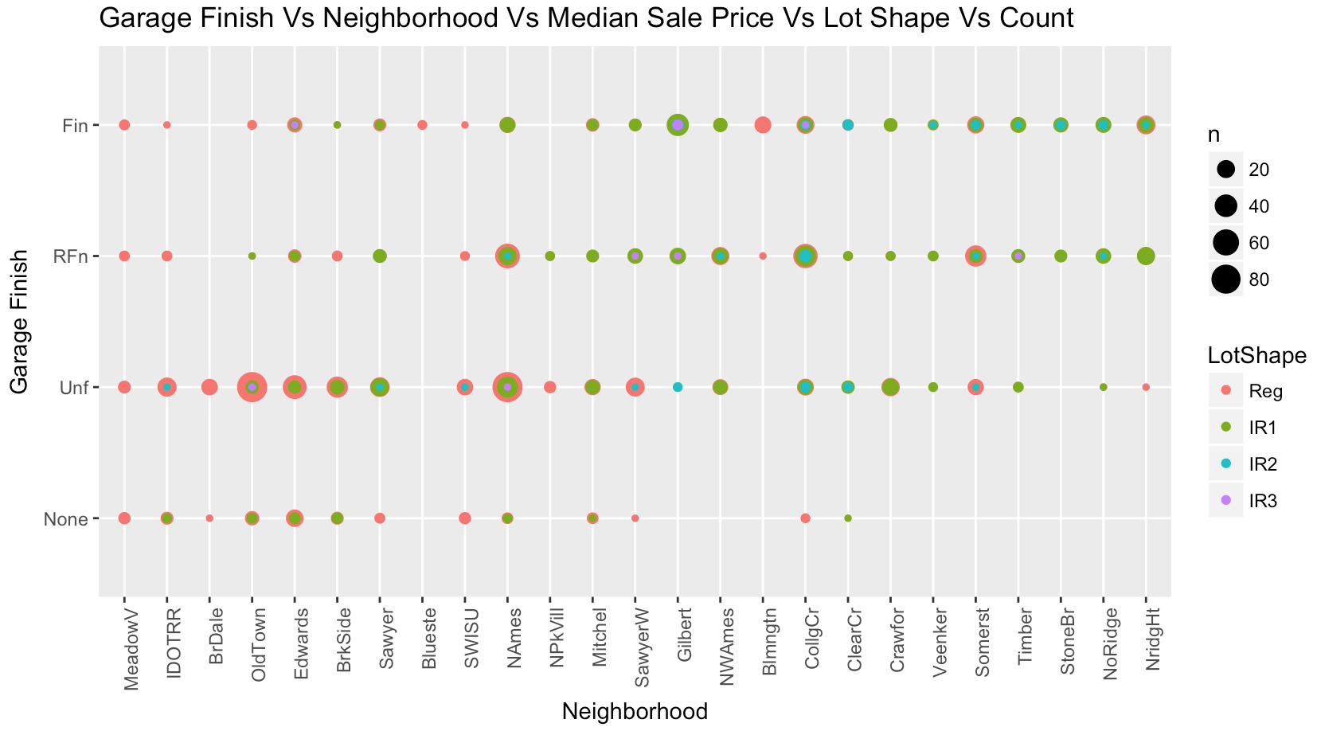
Multi-variate Analysis
Rich Neighborhoods have more IR2
( Moderately Irregular ) lot shapes.
Their garages are either
finished or roughly
finished

Slide 16
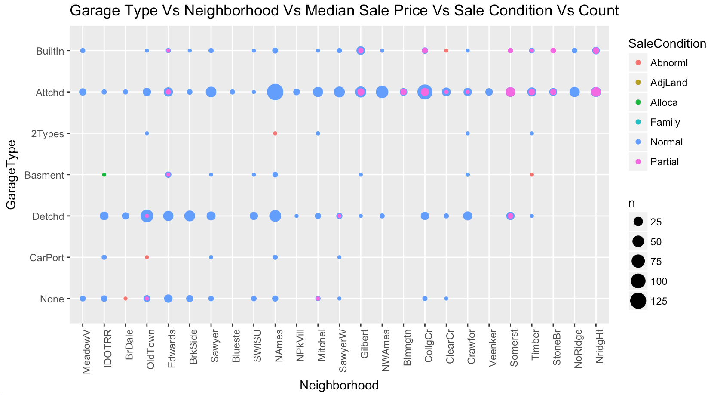
Multi-variate Analysis
Rich neighborhoods have more partial sale conditions.
Rich neighborhoods have more built-in and attached garages.

Slide 17
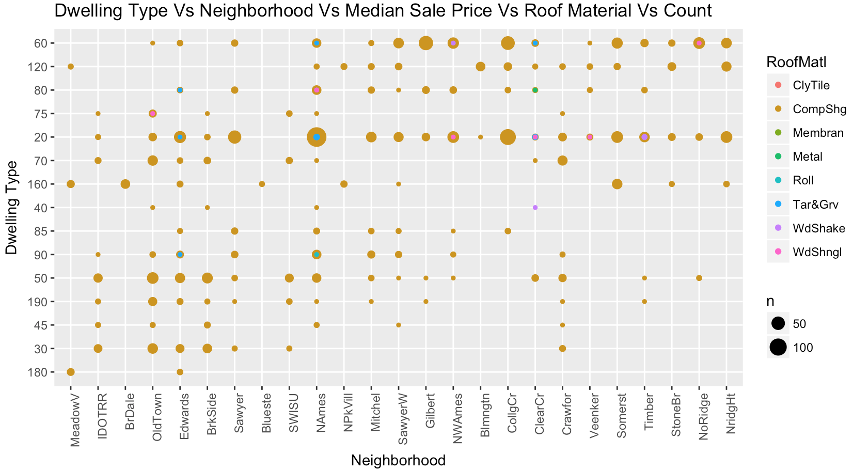
Multi-variate Analysis
Rich neighborhoods have more ClyTile (Clay Tile) and WdShake (Wood Shakes) roof materials.
Rich neighborhoods have more 2 stories.

Slide 18
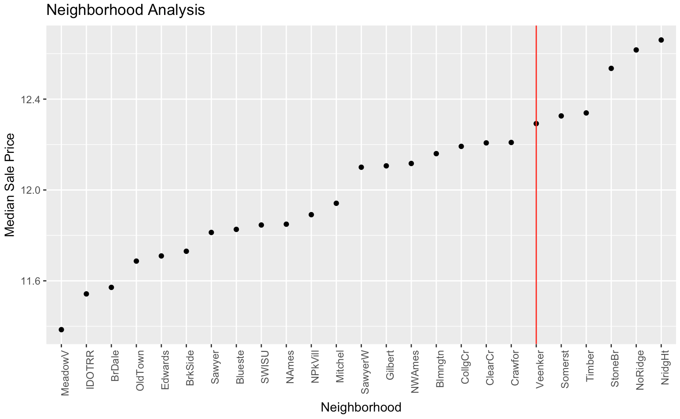
New variables
Anything on and after red line is a
Rich Neighborhood

Slide 19
MODELS

Slide 20
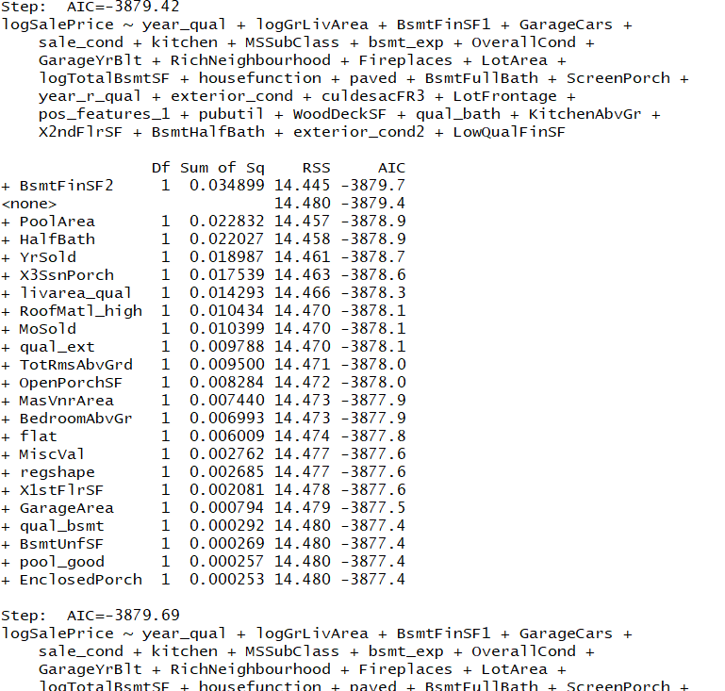
Step wise selection
Step wise regression:
Selecting a sub model based out of lowest AIC value
- But results of models with the best step wise model were relatively of lower accuracy

Slide 21
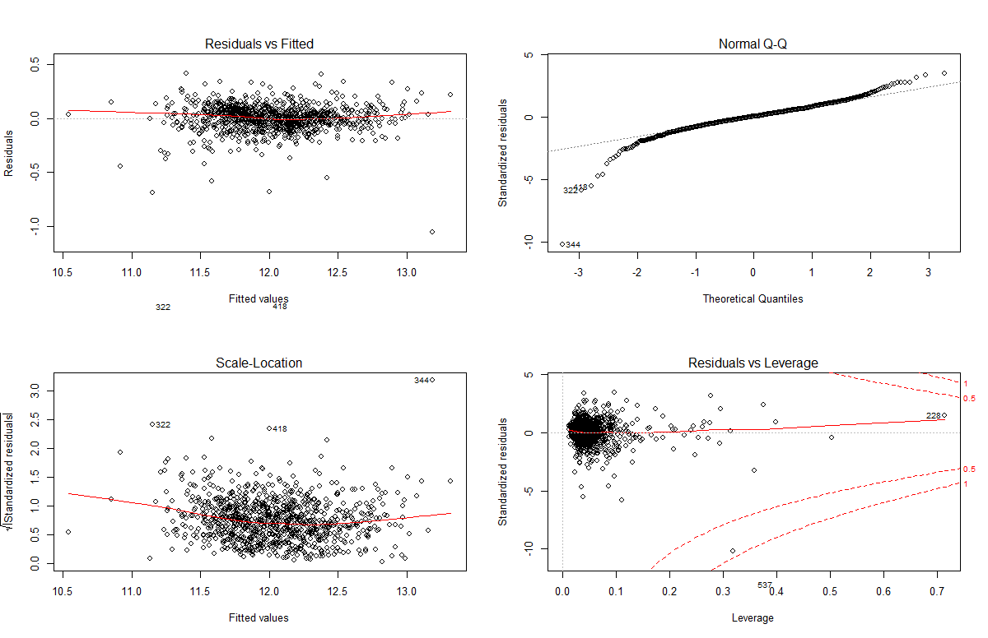
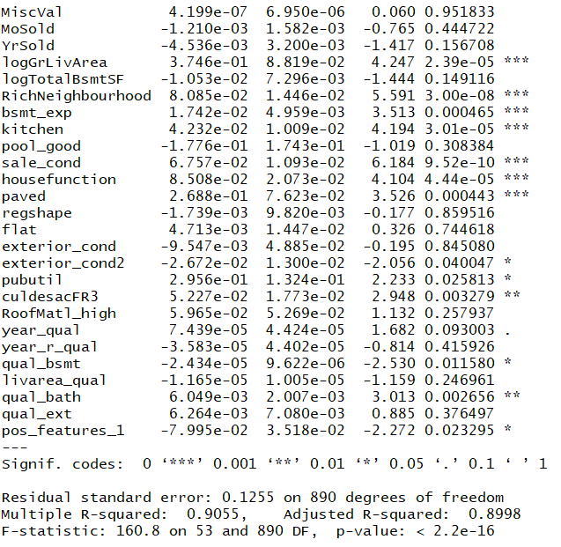
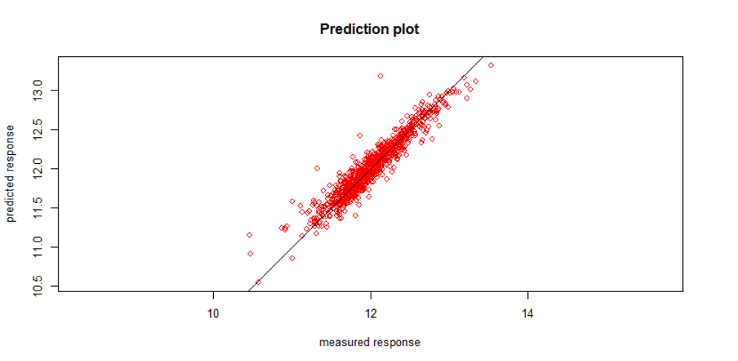
Linear Regression
RMSLE : 0.1302252

Slide 22
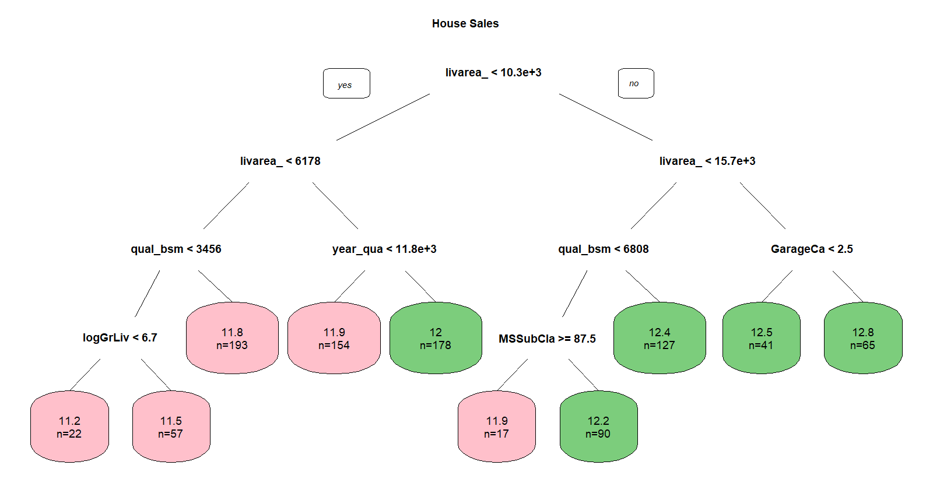
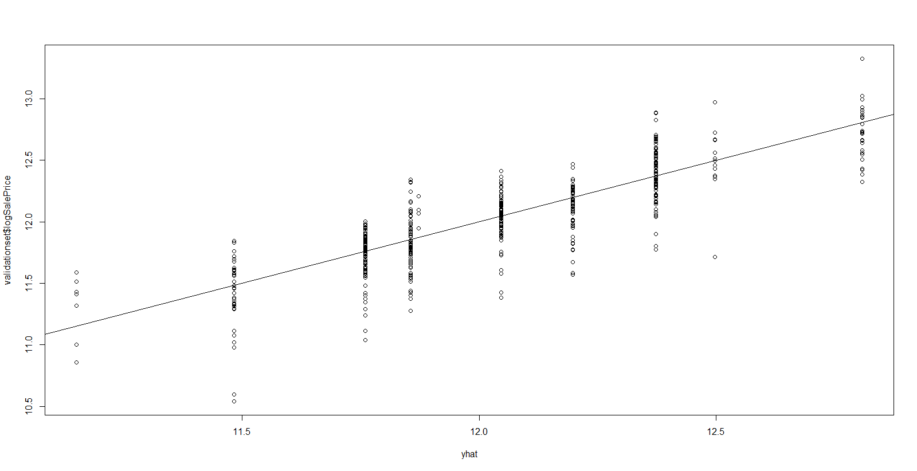
Decision Tree
RMSLE = .2196395

Slide 23
Support Vector Machine
SVM MODEL TYPE | LINEAR | RADIAL | POLYNOMIAL
COST | 0.001 | 5 | 0.1
GAMMA | 0.01886792 | 0.5 | 0.02631579
SUPPORT VECTORS | 611 | 866 | 754
DEGREES |  |  | 3
RMSLE | 0.1408446 | 0.3932813 | 0.185484
Notes:
Via best tuning method

Slide 24
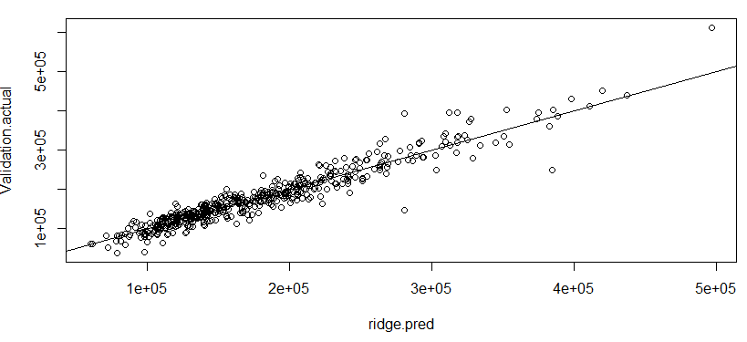
Penalized Models- Ridge and Lasso
Tuned model for optimal value of lamda: .01 yielded lowest MSE for both models
Which is better?
Ridge RMSLE: .131
LASSO RMSLE: .136
Combined RMSLE: .129

Slide 25
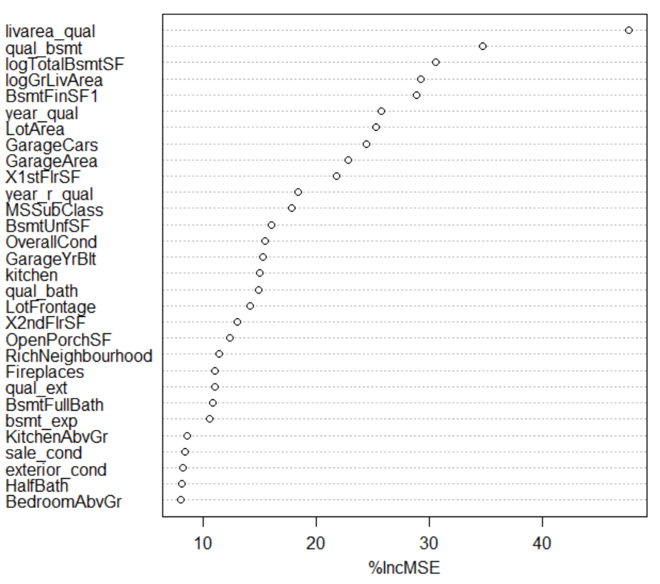
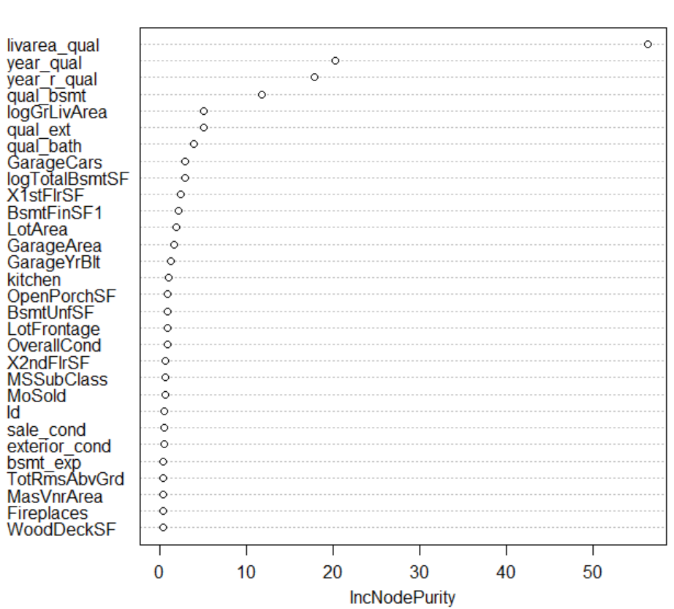
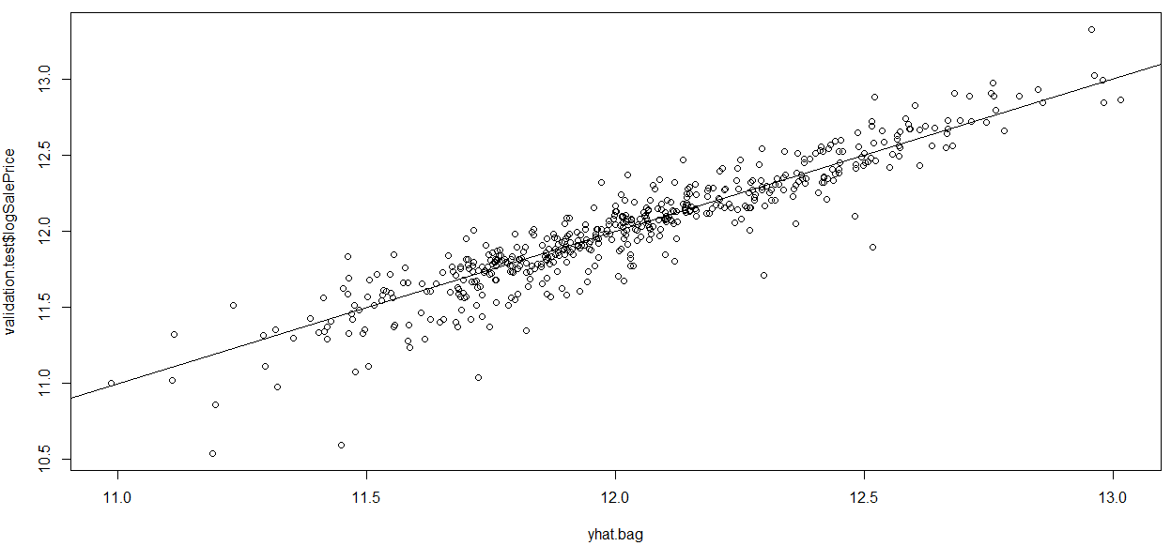
Random Forest- Bagging
Steps
Asses effect of parameters mtry and ntree
Tried dropping variables→ resulted in marginal change in performance
Best Model: mtry=28, ntree=1000
.1422 RMSLE

Slide 26
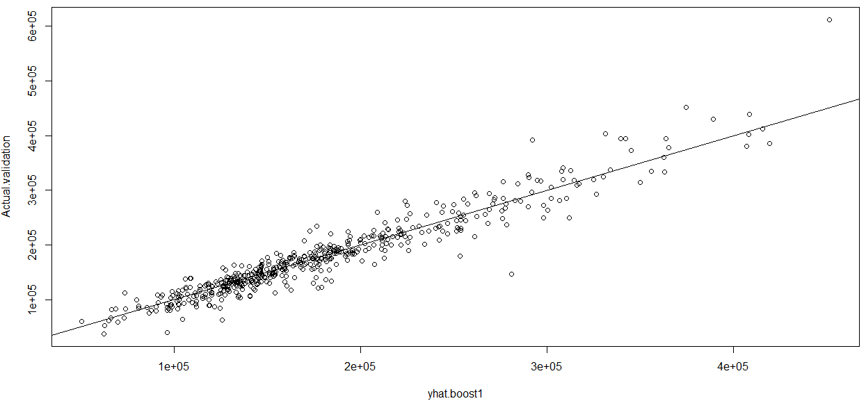
Random Forest- Boosting
Steps
Tried selected options for tuning parameters
Computational time made it impractical to test every combination
n.tree , interaction.depth, shrinkage
Dropped variables with no effect in model (p= 6)
Best Model: ntree:3000, interaction depth=4, shrinkage=.01
.1311 RMSLE

Slide 27
Best Model & Conclusion

Slide 28
Best Model
MODEL | ACCURACY PREDICTOR- RMSLE
LINEAR | 0.1302
RIDGE | 0.131
LASSO | 0.136
COMBINED PENALIZED (AVG RIDGE,LASSO) | 0.129
DECISION TREE | 0.2196
SVM (LINEAR) | 0.1408
SVM (RADIAL) | 0.3932
SVM (POLYNOMIAL) | 0.1855
RANDOM FOREST – BAGGING | 0.1422
RANDOM FOREST – BOOSTING | 0.1311
BEST ERROR RATE
IN
KAGGLE TEST DATASET

Slide 29
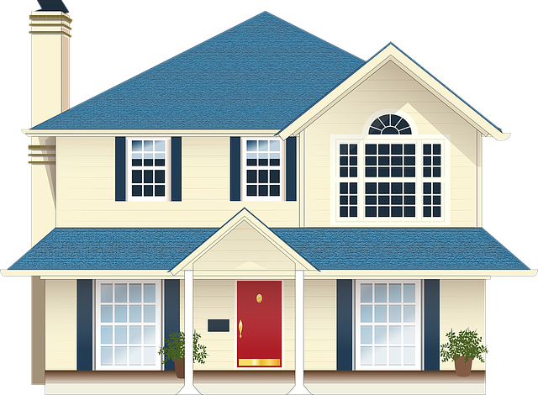

Conclusion
Which homes are good targets for flipping
What variables are most important for determining house price
What should the target list price be on homes
If renovating where would I get the most bang for my buck? What should I focus on?
Most influential variables:
Livable Area
Neighborhood
Basement size
Year Built
Sale Condition
Notes:
If we forego the higher accuracy of the penalized predictive model, we can add interpretability to the model !
Using our prediction to price homes as close to market value as possible to discourage negotiation i.e. "priced to sell"

Slide 30
Thank You
Q & A

